Slide 1
PROFESIONAL INTEGRITY
Dr. K. Priya Verthini

Slide 2
What is integrity
A quality of being honest having strong moral principles and moral uprightness.
The state of being whole and undivided having internal unity and coherence.
Our inner world drives our outward actions.
1. Integrity is an internal quality.
“The first thing is to be honest with yourself”
says Nelson Mandela
2. Other people may or may not notice.

Slide 3
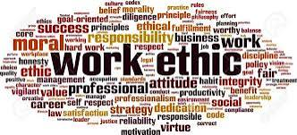
Work ethics has been understood as a value based on hard work and diligence (doing work carefully and diligence).
Work ethics is a set of moral principles or values that an employee abides by and uses in their job performance. It covers an employee's behavior and attitude towards their job, career, and the workplace

Slide 4
Why work ethics is important
A strong work ethic within the company serves as a behavioral model for the right way of working. It supports and fosters a productive working culture.
Employees with a strong work ethic are highly driven and often far exceed their peers in terms of achieving company goals.

Slide 5
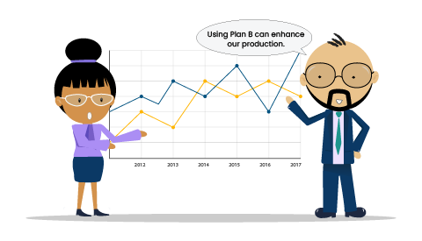

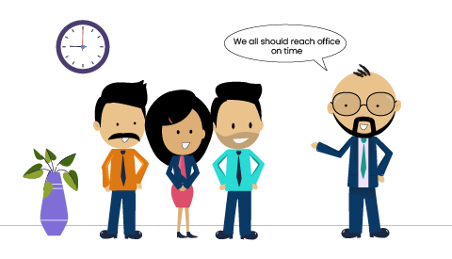
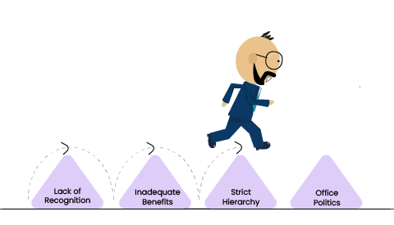
2. Proper Mentoring
1. Clear Goals and Objectives
3. Set a Good Example
4. Create the right Work Environment
5. Discipline
6. Understand your Employees’ Needs
7. A Culture of Constant Feedback
8. Eliminate Obstacles
Are the steps need to be taken main proper work ethics

Slide 6
ELEMENTS OF WORK ETHICS
1. PROFESSIONALISM
Being professional involves everything from how you dress and present yourself in the business world to the way you treat others. Professionalism basically embodies all the other elements of a strong work ethic.
2. ACCOUNTABILITY
You take personal responsibility for your actions and outcomes in every situation. As well as avoid making excuses when things don’t go as planned. Your mistakes should be taken as learning experiences and the ability to always better yourself must be upholded.
3. RESPECTFULNESS
Whether you’re serving a customer, meeting with a client or collaborating with colleagues, you do your best to respect everyone’s opinions, especially under difficult circumstances. This shows you value people’s individual worth as well as their professional contributions.

Slide 7
ELEMENTS OF WORK ETHICS
4. DEDICATION
You don’t stop until the job is done, and done right. When you’re fully dedicated, you have to strive to achieve the best results alongside putting in the extra hours to get things right.
5. DETERMINATION
You don’t let obstacles stop you, and enthusiastically embrace challenges You know that your job as an entrepreneur is to solve your clients’ problems. With that, continuously seek better and more innovative answers.
6. HUMILITY
You acknowledge everyone’s contributions, and freely share credit for accomplishments. You show gratitude to colleagues who work hard, and appreciation to your loyal clients. And, while you always take your work seriously, you strive always to maintain a sense of humor about yourself.
7. DEPENDABILITY
This relates closely to when you are always on time and prepared for meetings. Not only that but also have the ability to deliver your work on time. With no doubt, your customers, colleagues and clients will appreciate the stability you portray.
All in all a strong work ethic is very relevant to any business as it can set the work productivity in a business. The smallest of things will always make a world of a difference, in this case, it can definitely utilize a sense of belonging in the work environment.

Slide 8
Service learning
Service-learning is an educational approach that combines learning objectives with community service in order to provide a pragmatic, progressive learning experience while meeting societal needs.
Defined as
"Service-learning is a pedagogy integrating academically relevant service activities that address human and community needs into a course. Students connect knowledge and theory to practice by combining service with reflection in a structured learning environment”.
Qualities of service learning
Integrative - (mixing things or people together that were formerly separated). A situation to learn how the society is.
Reflective
Contextualized
Strength based
Lifelong

Slide 9
Service learning
Direct Service
Involves student engagement with the client population on an interpersonal level. The engagement is performed at the site of service. Examples of direct service include tutoring, reading to the elderly, coaching a youth activity in a low-income area.
Indirect Service-Learning
Students fulfill a community need identified by a community partner without engagement with the client population. Examples of indirect service may include planning fundraising activities for a community organization, developing a social media strategy for a community action group, designing posters or flyers for a local nonprofit, building low-income housing, cleaning a community park.
Research-Based Service-Learning
A type of service that involves collaboration with a community partner to conduct research that addresses community issues or needs. Partners may be nonprofit groups, government agencies or community leaders. Examples of community-based research projects would include testing water reports provided to a local community, auditing energy use in public housing, gathering data for a community grant application, gathering research that assists in the development of a video for a nonprofit or government agency.
Advocacy-Based Service-Learning
A type of service where students create awareness or educate others on public topics that are of concern to the community partner and/or the greater community. Examples of this type of service would include planning and executing public forums that address community issues, writing and distributing information that illuminates a problem experienced by the community, helping to draft legislation that helps solve a community need, organizing a letter-writing initiative that addresses a social issue.

Slide 10
Civic virtue
Civic virtue is morality or a standard of righteous behavior in relationship to a citizen’s involvement in society
Civic virtue is the harvesting of habits important for the success of the community
Eg. voting

Slide 11
RESPECT FOR OTHERS
Respect, also called esteem, is a positive feeling or action shown towards someone or something considered important or held in high esteem or regard.
It is also the process of honoring some one by exhibiting care, concern or consideration for their needs or feelings.
Eg…conveying thanks or wishing them

Slide 12
How to respect others
Listening to the other person (at time of clashes)
Being empathetic, understanding each other and putting ourselves in their shoes.
Apologizing to each other when we make mistakes
Complying with and respecting laws and regulations
Respecting the privacy and intimacy of others
Being grateful.

Slide 13
Caring and sharing
Caring includes feelings, relationship, protecting others and causing least damage to others.
Caring is feeling for others.
It includes showing respect to the feeling of others and also respecting and preserving the interests of all others concerned

Slide 14
sharing
Sharing means ‘sharing of feeling, ideas thoughts, resources and profits. Sharing is always mutually beneficial.
Sharing is voluntary and it cannot be driven by force, but motivated successfully through ethical principles.
Sharing should be genuine, legal, positive, voluntary and without any expectation in return.

